Slide 1
GIT (local) vs Git Hub (remote)

Slide 2
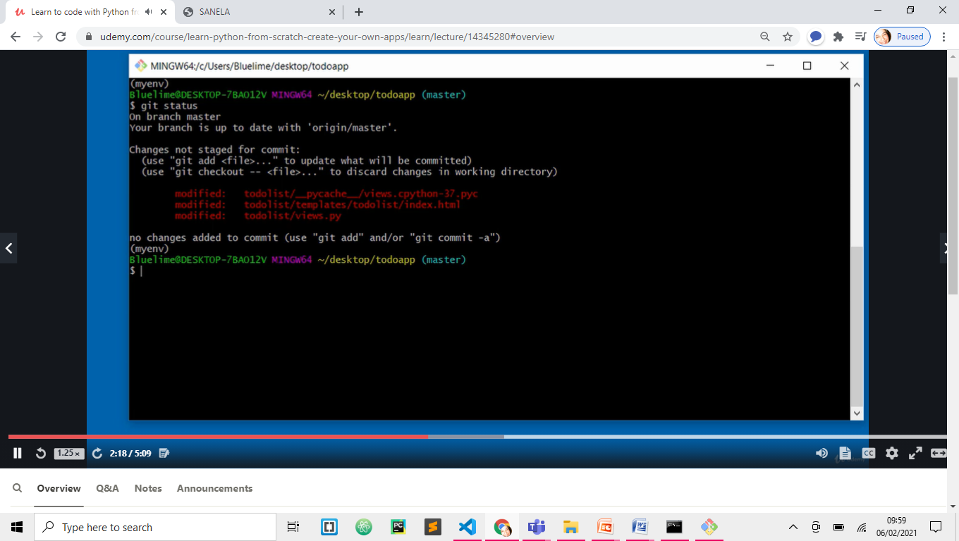
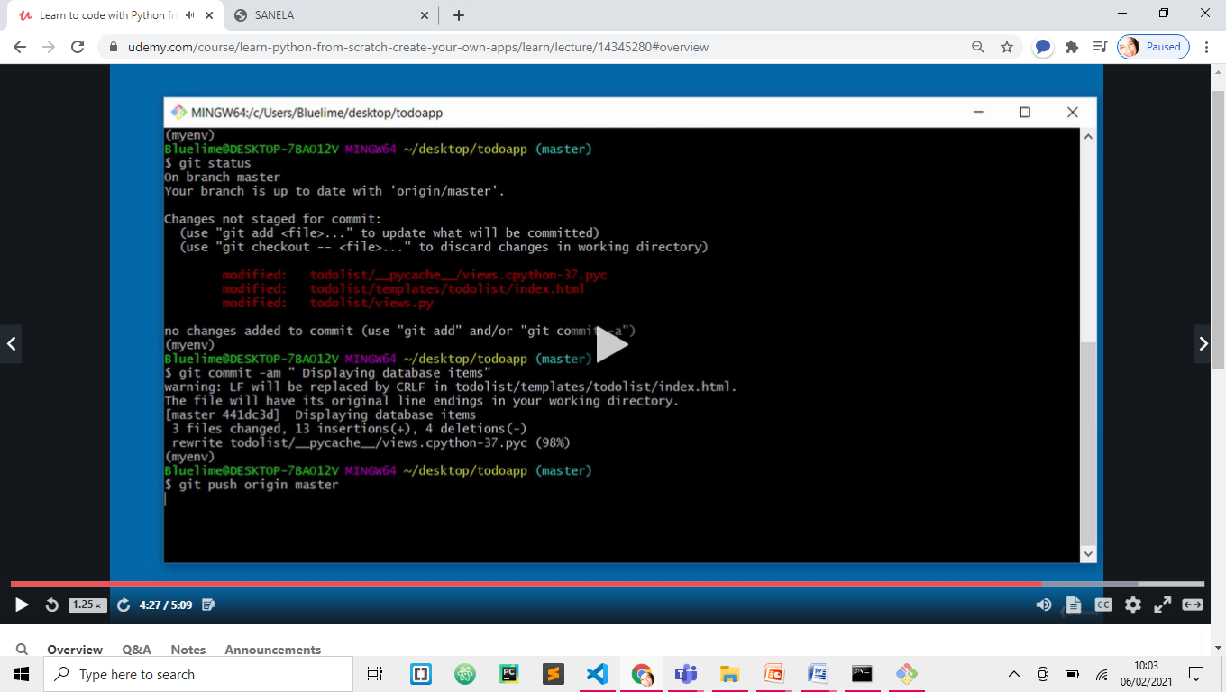
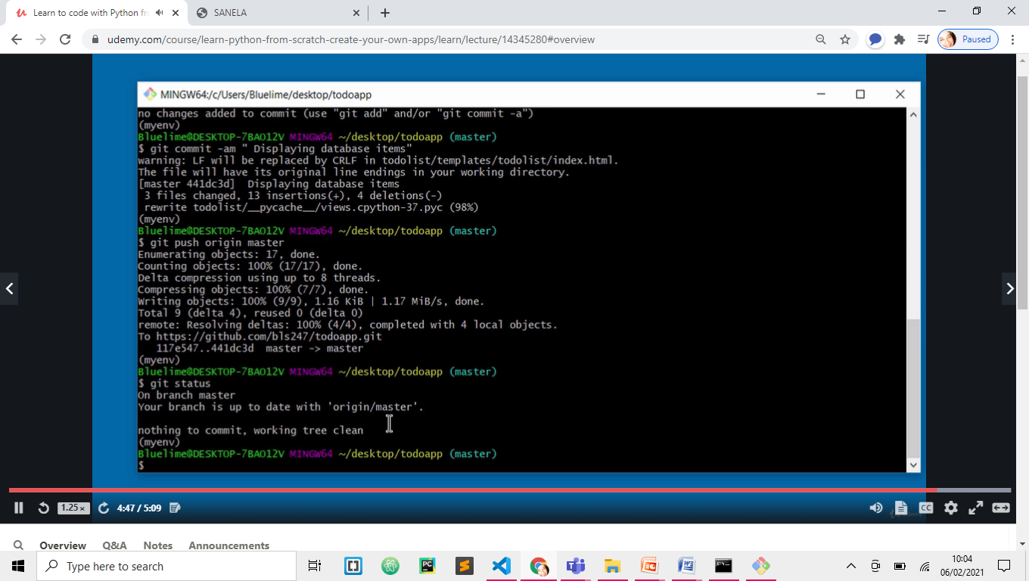
GIT
HISSSSSSSSSSSSSSSSSSSSSSSSSSSSSs
In GIT BUSH
>>git status
RED – all new changes
>>git diff ???????????? Compare with last commit
to exit this q ?????????????????
>>git commit –am “Displaying database items”
Commit code to remote repository
-a automatically add any files
m – add message at the same time
>>git push origin master
Push code (LOCAL-MASTER) up to remote repository
On GIT HUB (ORIGIN)
>>git status -----this time nothing to commit
(master)
(myenv)
CONTROLLER – Dragana -----

Slide 3
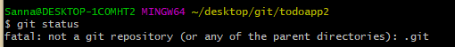
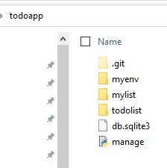
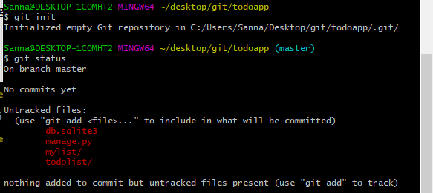
GIT PRIOR
>>git status
Would not work when we do not gave even GIT repository initialised
todoapp>>git init

Slide 4
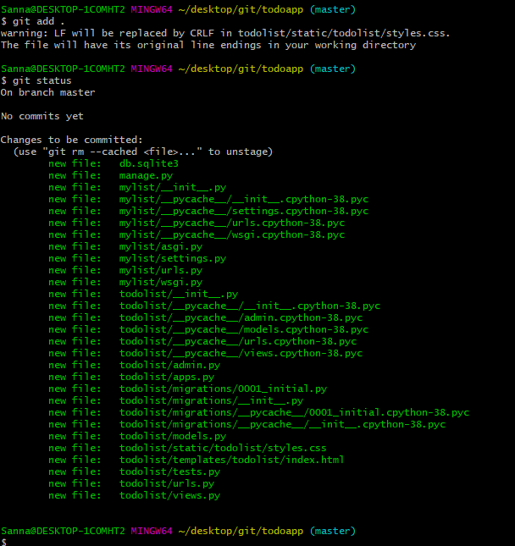
Add to STAGING area

Slide 5
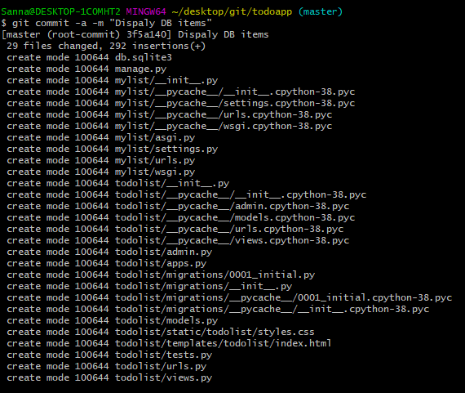
git commit –m “…” MY WAY
git commit –a -m “…” HIS WAY
git commit -am “…”
A and M
STAGE and COMMIT I one go

Slide 6
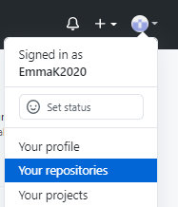
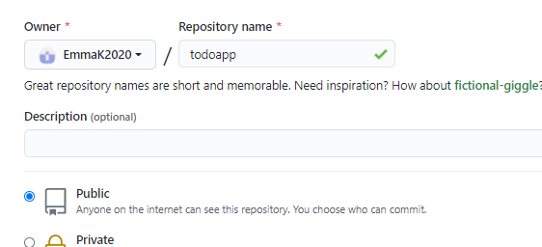
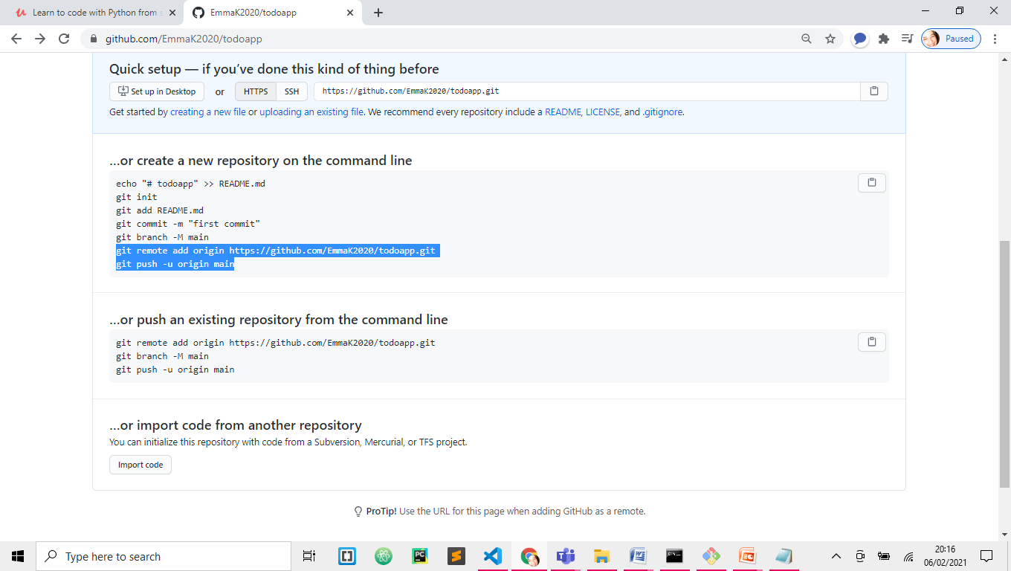
PUSH – I do not have remote repository yet
github.com
EmmaK2020
sannak2017@gmail.comD...3%
I created new repository TODOAPP on GitHub
Copy these two files in GitBush
master instead of main

Slide 7
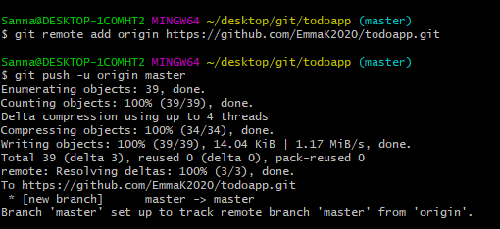
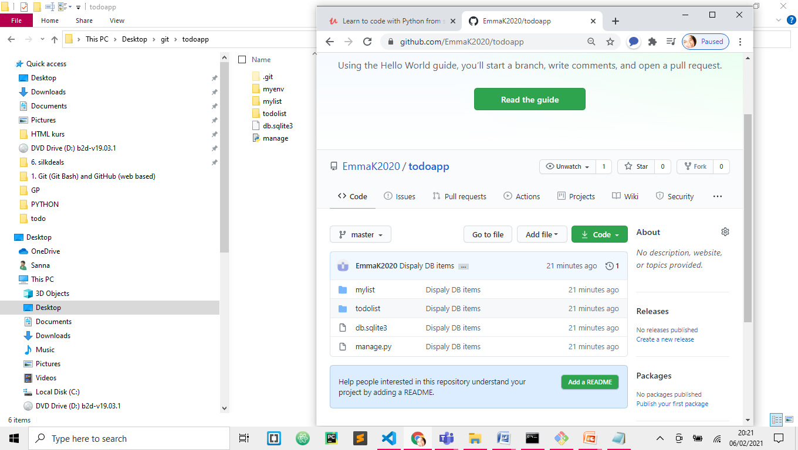
On GitHub refresh ´this page
This will come up
VE and .GIT do not get copied

Slide 8
GIT Section 22 (ToDoApp) task 234

Slide 9
GIT
Even if I had git repository from before it was giving me error:
'git' is not recognized as an internal or external command, operable program or batch file.
So I had to:
Modifying PATH on Windows 10:
In the Start Menu or taskbar search, search for "environment variable".
Select "Edit the system environment variables".
Click the "Environment Variables" button at the bottom.
Double-click the "Path" entry under "System variables".
With the "New" button in the PATH editor, add C:\Program Files\Git\bin\ and C:\Program Files\Git\cmd\ to the end of the list.
Close and re-open your console.

Slide 10
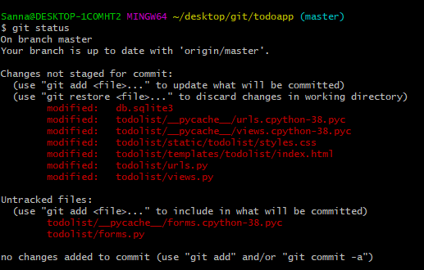
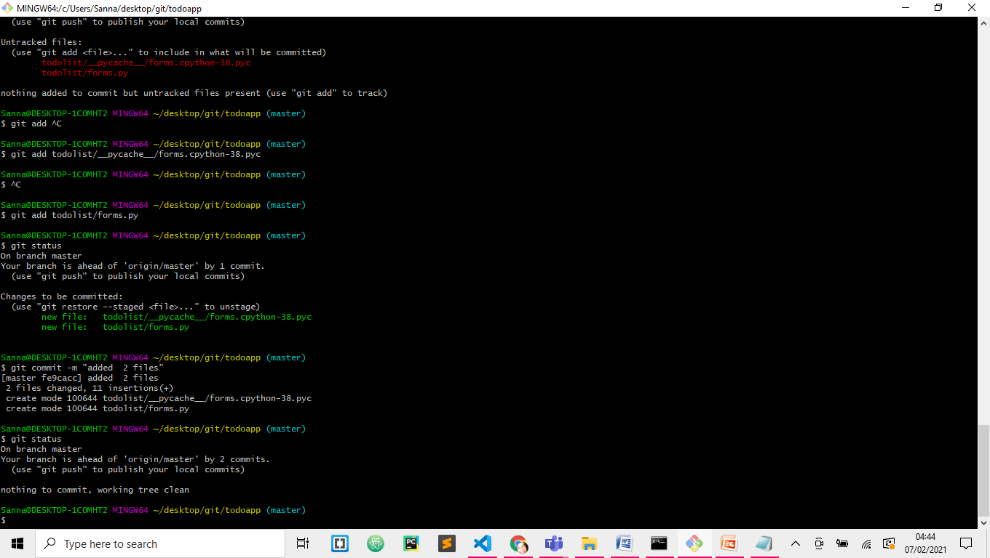
GIT – upload changes
>>git status
To see changes since last commit
>>git commit –am “Added functions to buttons”
Git is telling me that there are two files which I need to ADD

Slide 11
I have added them, they are not RED any more, but GREEN as they need to be commited
New git status is telling you that there in nothing to commit

Slide 12
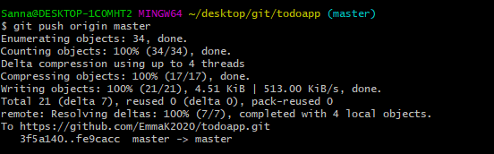
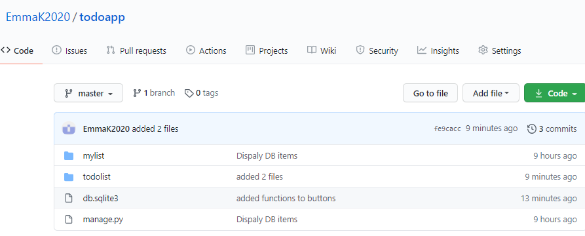
PUSH from local (GIT) to remote (GIT HUB) repository
>>git push origin master
www.github.com
EmmaK2020
SannaK2017@gmail.com
D…3%
9 min ago
All together 3 commits

